Slide 1


Slide 2
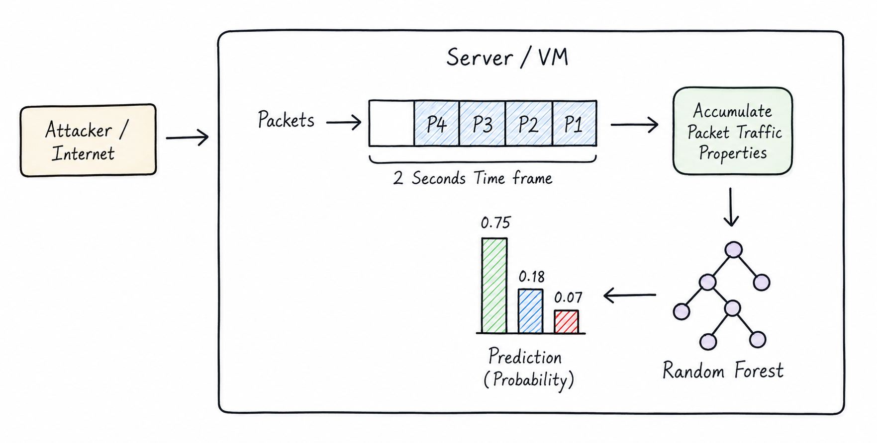

Slide 3
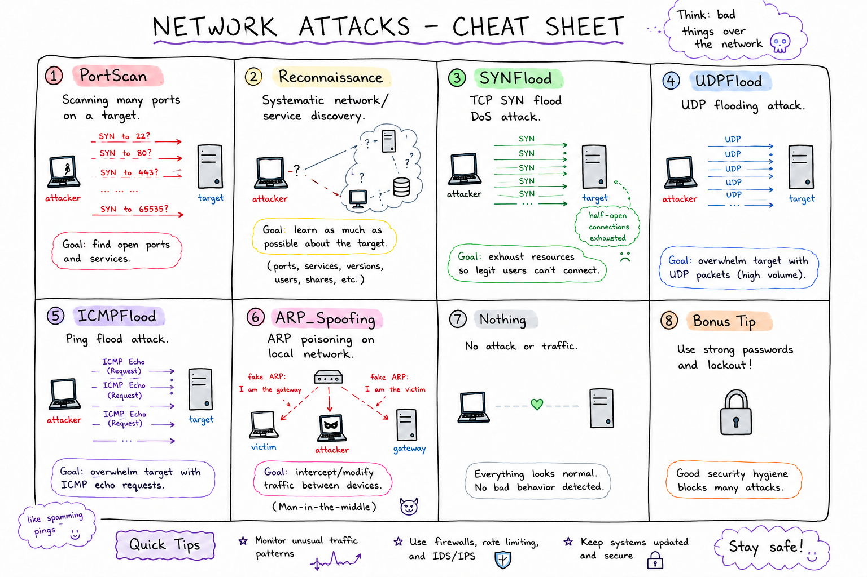

Slide 4
Network Attacks
PortScan → Checks many ports on a system to find open services. Like trying many doors to see which are unlocked.
Reconnaissance → Collecting information about a target network, devices, or services before an attack. Like scouting the area first.
SYNFlood → Sends huge numbers of TCP SYN requests to overload a server and block real users.
UDPFlood → Floods a target with large amounts of UDP packets, consuming bandwidth and resources.
ICMPFlood → Sends excessive ping (ICMP) requests to slow down or crash a system/network.
ARP_Spoofing → Fakes ARP messages on a local network to intercept or redirect traffic. Often used in man-in-the-middle attacks.
Nothing → No attack or suspicious behavior detected.

Slide 5
Packet features used By model to predict
packet_count — Total number of network packets observed in a time window.
byte_count — Total amount of data transferred, measured in bytes.
packets_per_second — Rate of packet transmission per second; useful for detecting floods or bursts.
bytes_per_second — Data transfer speed in bytes per second.
tcp_count — Number of TCP packets detected.
udp_count — Number of UDP packets detected.
icmp_count — Number of ICMP packets (like ping requests/replies).
arp_count — Number of ARP packets used for IP-to-MAC address resolution.
syn_count — Number of TCP SYN packets used to start connections; high values may indicate SYN flood attacks.
ack_count — Number of TCP ACK packets acknowledging received data.
rst_count — Number of TCP RST packets used to abruptly terminate connections.
unique_destination_ports — Count of different destination ports contacted; high values can indicate port scanning.
unique_destination_ips — Count of distinct destination IP addresses contacted; useful for detecting reconnaissance or spreading activity.
new_connections — Number of newly established network connections during the observation period.
failed_connections — Number of connection attempts that failed or were rejected.
syn_ack_ratio — Ratio of SYN packets to ACK packets, A very high ratio can indicate incomplete handshakes or SYN flood attacks.
dns_query_count — Number of DNS requests made.
avg_dns_query_length — Average size/length of DNS query names; unusually long queries may indicate tunneling or suspicious activity.

Slide 6
ssh_connections — Number of SSH protocol connections detected. ​
ftp_connections — Number of FTP protocol connections detected. ​
outbound_bytes — Amount of outgoing data sent from the monitored device/network. ​
inbound_bytes — Amount of incoming data received. ​
outbound_inbound_ratio — Ratio of outgoing to incoming traffic; abnormal ratios may indicate data exfiltration. ​
top_destination_port_count — Frequency of traffic to the most targeted destination port. ​
unique_macs_claiming_same_ip — Number of different MAC addresses using the same IP address; can indicate ARP spoofing or IP conflicts. ​
label — Target classification/category for the traffic sample (e.g., Normal, PortScan, SYNFlood, Reconnaissance).​

Slide 7
Limitations
Cannot inspect encrypted payload contents such as HTTPS or VPN traffic.
Performance depends on the quality and diversity of the training dataset.
May produce false positives on unusual but legitimate traffic.
Primarily detects attack patterns represented in the training data.
Visibility is limited to traffic observed on the monitored interface.
Resource usage increases on high-speed networks.

Slide 8
Future Scope
Integration of deep learning models such as CNNs or LSTMs.
Automated response mechanisms to block malicious traffic.
Distributed IDS deployment across multiple hosts.
Integration with Security Information and Event Management platforms.
Improved feature extraction and behavioral analysis.

